Slide 1
BALLARI INSTITUTE OF TECHNOLOGY AND MANAGEMENT
DEPARTMENT OF COMPUTER SCIENCE AND ENGINEERING
NOVEL APPROACH TO DETECT PLAGIARISM IN THE DOCUMENT
Guide
Dr. R. N. Kulkarni, CSE, BITM Ballari
Co-Ordinator
Prof. C K SRINIVAS, CSE, BITM Ballari
PRESENTED BY
A PRATHAP REDDY | 3BR19CS001
HARSHITHA B | 3BR19CS019
CHITRIKI GANESH | 3BR19CS040
DILIP KUMAR B K | 3BR19CS044

Slide 2
ABSTRACT
Plagiarism is a growing problem in Education and Technology due to the wide availability of resources and data.
Existing plagiarism detection tools are not always accurate, especially when documents contain both text and images.
An exhaustive searching technique is proposed that can search text, images, and even text embedded in images.
The proposed method uses various file formats, including .docx, .pdf, and different image formats.
The tool verifies the input document with website content and provides results based on similarity.

Slide 3
OBJECTIVES
To read the text from the input document.
To generate similarity index report for the input document.
Display or highlight the location of plagiarism and generate a detailed report.

Slide 4
PROBLEM STATEMENT
To design, develop and implement a software system to detect plagiarism in an input document.

Slide 5
FUNCTIONAL REQUIREMENTS
Input: The system must accept input in the form of a text or as different formats such as text, PDF, Word documents and other image formats like (.png, .jpeg, .jpg and .bmp).
Preprocess: The system must have functionality of preprocessing the data input by the user.
Search Engine: The system must be equipped with a search engine that fetches related links present on the Internet.
Scrapping: To scrape the content from acquired links, the system must contain a scrapper.

Slide 6
FUNCTIONAL REQUIREMENTS
Evaluating Similarity: The system must determine how closely the suspect input data resembles the content present in the matching sources.
Report Generation: The system must produce thorough reports on all instances of plagiarism discovered, including the proportion of similarity and the content's source.
Accuracy: Minimum errors must be produced by the system in order to deliver reliable findings.

Slide 7
NON – FUNCTIONAL REQUIREMENTS
Performance: The Application is built in such a way by taking all the necessary precautions and this as gone through rigorous testing in order to ensure the user a swift feel.
Availability: It will be available only when there is an internet connection because it is an online application.
Usability: The user interface is made so responsive which would make the user to easily work with the software.
Robustness: The System can withstand or overcome adverse conditions or rigorous testing.
Maintainability: The Software is built so simple such that any further updates if required can be implemented easily.

Slide 8


Input Document (formats: .jpg, .jpeg, .png, .docx, .pdf,.bmp)
Extracting Text from the input document
Fetching links from the internet that matches the extracted text from the Suspicious document.
Extracting Content from the links obtained (by parsing the HTML documents)
FLOW CHART
Text Pre-processing
Cleaning
Tokenizing
Lower casing
Removing stop-words
Trigram generation
Removing punctuations
lemmatization
Trigrams
Feature Extraction
Tf – Idf vectorizer
Features (Frequency Vectors)
> 15%
Generating Similarity Index
< 15%
Plagiarised
Not Plagiarised

Slide 9
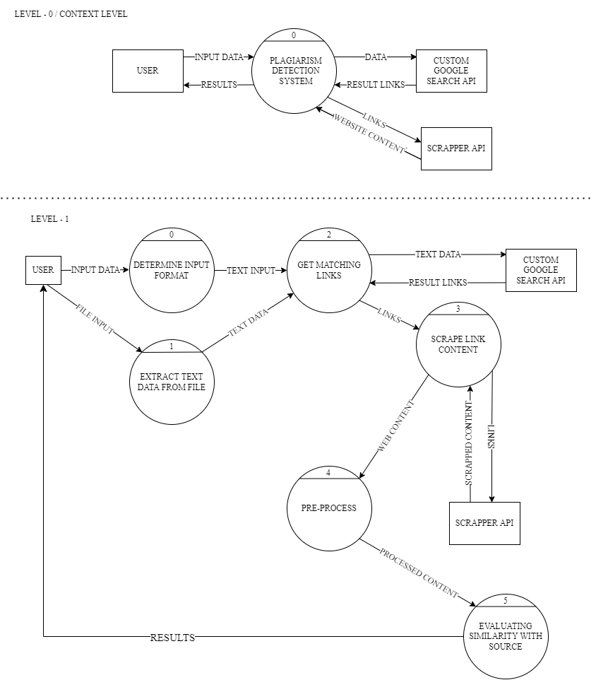
DATA FLOW DIAGRAM

Slide 10
IMPLEMENTATION
The computational logic of the system has been completely coded in Python. Hence, we opted for FastAPI a Python web framework, HTML5, CSS3, and Bootstrap5 to build a web interface.
Modules:
main
Driver
ScrapContent
Stripper
Convert
textPreProcessing
plagCheck

Slide 11
IMPLEMENTATION
Description of Modules:
main: This acts as the entry point, which contains GET and POST methods that let the user interact with the system.
Driver: This module has all the function calls required for the further computations. (i.e., it has the function calls to different functions required in the process).
ScrapContent: This Module has two following methods
get_urls: Fetches the related links using Google's custom search engine API with respect to the input data.
get_content: scrape data from obtained links using scrapper API.
Stripper: In this module, the method remove_tags will remove HTML tags like style, script, and head from scraped data using bs4 and return the string.

Slide 12
IMPLEMENTATION
Convert: This Module has four following methods
word_to_txt: If the input file format is a .docx (a Word document), then this method will be executed to extract text from a Word document using docx2txt.
pdf_to_txt: If the input file format is a .pdf (pdf document), then this method will be executed to extract text from a pdf document using pdfminer.high_level.
img_to_txt: If the input file format is an image format, then this method will be executed to extract text from an image file using Pytesseract and PIL.
download_pdf: if copied content found in .pdf file available online then this method extracts text from .pdf file.

Slide 13
IMPLEMENTATION
textPreProcessing: This Module has two following methods
Preprocess: In this method, the text extracted in the previous steps undergoes various cleaning processes such as case conversion (to lowercase), removing stop-words, removing punctuation, and lemmatization using spacy.
string_matching: This method is used to compare strings (the suspicious and the source string) by three words using the trigram approach.
plagcheck: This Module has three following methods
vectorize: This method converts the text data into tf-idf vectors using TfidfVectorizer.
similarity: This method Generates the similarity Index using cosine_similarity.
check_plagiarize: This method detects plagiarism with respect to the input using the above two methods.

Slide 14
PUBLICATION STATUS
Submission summary:
Track Name: ICDCECE2023.
Conference Name: International Conference On Distributed Computing And Electrical Circuits And Electronics.
Paper ID: 304.
Paper Title: NOVEL APPROACH TO DETECT PLAGIARISM IN THE DOCUMENT.
Created on: 3/14/2023, 11:28:13 AM.
Last Modified: 3/16/2023, 11:09:07 PM.

Slide 15
REFERENCES
[1] Vandana, "A Comparative Study of Plagiarism Detection Software," 2018 5th International Symposium on Emerging Trends and Technologies in Libraries and Information Services (ETTLIS), 2018, pp. 344-347, Doi: 10.1109/ETTLIS.2018.8485271.
[2] Prof.Sneha Autade, Anuja Suryawanshi, A Systematic Literature survey on Plagiarism detection Tools, International Journal of Application or Innovation in Engineering & Management (IJAIEM), Volume 7, Issue 2, February 2018, pp. 030-034, ISSN 2319 - 4847.
[3] Imene Bensalem, Paolo Rosso, Salim Chikhi, Intrinsic Plagiarism Detection using N-gram Classes, Proceedings of the 2014 Conference on Empirical Methods in Natural Language Processing (EMNLP), pages 1459–1464, October 25-29, 2014, Doha, Qatar. c 2014 Association for Computational Linguistics.
[4] Kanjirangat, Vani & Gupta, Deepa. (2016). A Study on Extrinsic Text Plagiarism Detection Techniques and Tools. JOURNAL OF ENGINEERING SCIENCE AND TECHNOLOGY REVIEW. 9. 150-164. 10.25103/jestr.095.02.
[5] V. Ljubovic and E. Pajic, "Plagiarism Detection in Computer Programming Using Feature Extraction from Ultra-Fine-Grained Repositories," in IEEE Access, vol. 8, pp. 96505-96514, 2020, Doi: 10.1109/ACCESS.2020.2996146.
[6] M. A. C. Jiffriya, M. A. C. A. Jahan and R. G. Ragel, "Plagiarism detection on electronic text-based assignments using vector space model," 7th International Conference on Information and Automation for Sustainability, 2014, pp. 1-5, Doi: 10.1109/ICIAFS.2014.7069593.
[7] Abdelhamid, Mehdi & Azouaou, Faical & Batata, Sofiane. (2022). A Survey of Plagiarism Detection Systems: Case of Use with English, French and Arabic Languages.
[8] Muharram Mansoorizadeh & Taher Rahgooy. Persian Plagiarism Detection Using Sentence Correlations.
[9] S. Prasanth & R. Rajshree & B. Saravana Balaji. (2013). A Survey on Plagiarism Detection. International Journal of Computer Applications. 86. Doi: 10.5120/15104-3428.

Slide 16
Thank you

